Slide 1


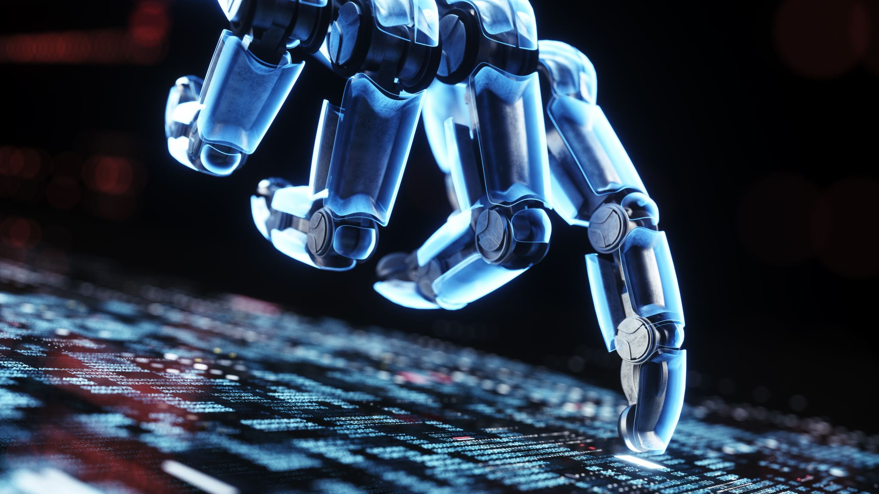
Demystifying AI Myths in Cybersecurity
Notes:
Thank you for joining me today for this presentation titled ‘Demystifying AI Myths in Cybersecurity.’ As we dive into the world of AI, it’s clear this technology is revolutionizing how we protect our digital landscapes—but along with its promise, there’s a lot of confusion fueled by myths. Today, we’re going to tackle those head-on

Slide 2
Who am I
Lead InfoSec Engineer
Experienced in Vulnerability Management, Incident Response, Threat Hunting, Threat Intelligence, SOC management…
Hospitality, DoD, Healthcare, Financial Industries.
M.S. in Cybersecurity
M.S. in Applied AI (University of San Diego, December 2024)

Slide 3
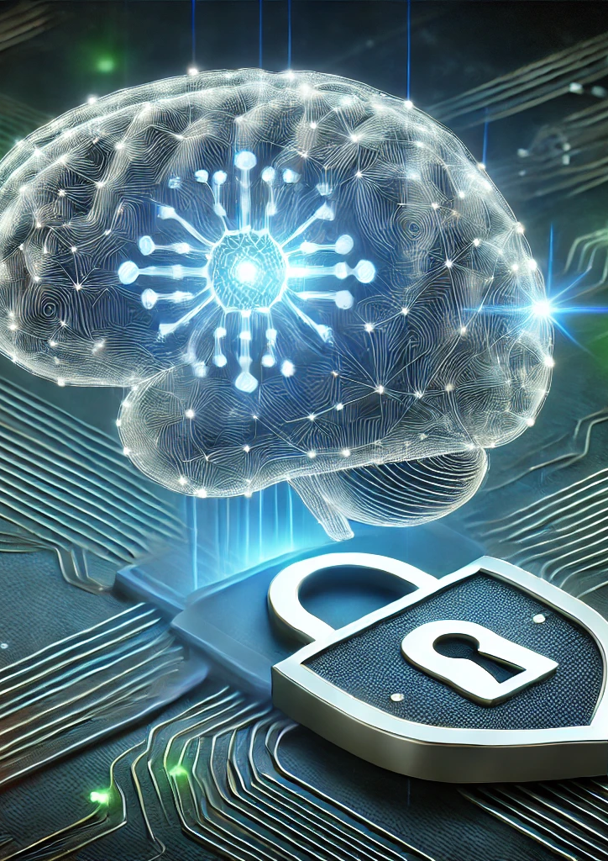
Introduction
This presentation aims to dispel common myths about Artificial Intelligence (AI), such as the belief that AI will replace all jobs, machines can achieve consciousness, or AI systems are infallible. By exploring AI’s true capabilities, current limitations, and ethical challenges, we’ll foster a balanced perspective on its role in our lives and industries. Attendees will leave with a clearer understanding of what AI can and cannot do, underscoring the critical need for human oversight in its development and application.
Notes:
Let’s start with the big picture.
There are three common misconceptions we’ll address:
First, the idea that AI will replace all cybersecurity jobs.
Second, the belief that machines can achieve consciousness and make ethical decisions on their own.
And third, the notion that AI systems are perfect and error-free.
These myths can shape how we perceive and use AI, often leading to unrealistic expectations.
Over the next minutes, we’ll explore AI’s true capabilities, its current limitations, and the ethical challenges it poses, all within the context of cybersecurity.

Slide 4
Myth #1 “AI is Infallible”
Notes:
Alright, let’s transition to our first myth: the idea that AI systems are perfect and error-free.
This is a dangerous assumption, especially in cybersecurity, where mistakes can have serious consequences.

Slide 5
reality
AI is only as good as the data it’s trained on.
ChatGPT jailbreaks, bias in facial recognition.
Cybersecurity professionals must validate AI-generated alerts.
Notes:
The truth is, AI can fail. It might be trained on poor data, encounter unforeseen scenarios, or fall victim to adversarial attacks—like hackers crafting malware to evade detection using adversarial machine learning. For example, an AI intrusion detection system might miss a threat or flag a harmless action as dangerous, leading to false positives or negatives.
Cybercriminals have successfully manipulated generative AI (like ChatGPT) to produce restricted content, bypassing safety controls.
Facial Recognition Bias in Security:
Some AI-based biometric authentication systems misidentify people based on race or gender.
Example: Studies have shown facial recognition AI has higher error rates for people of color.
Why Human Oversight Matters:
Interpreting AI-Generated Alerts:
AI may flag suspicious behavior, but humans must analyze context before taking action.
Example: An AI might flag an unusual login—a human analyst determines whether it’s an actual attack or just an employee on vacation.
Adjusting for New Threats:
Cyber threats constantly evolve, and AI requires updates and retraining to remain effective.
Example: New malware strains might bypass an AI model trained on outdated attack data.

Slide 6
Myth #2 “AI Will Become Sentient”
Notes:
Now, let’s address the second myth: the idea that machines can achieve consciousness and make ethical decisions.
This one often comes up in sci-fi movies, but in reality, AI is far from that. It’s built on algorithms and data—it doesn’t think, feel, or reason like a human

Slide 7
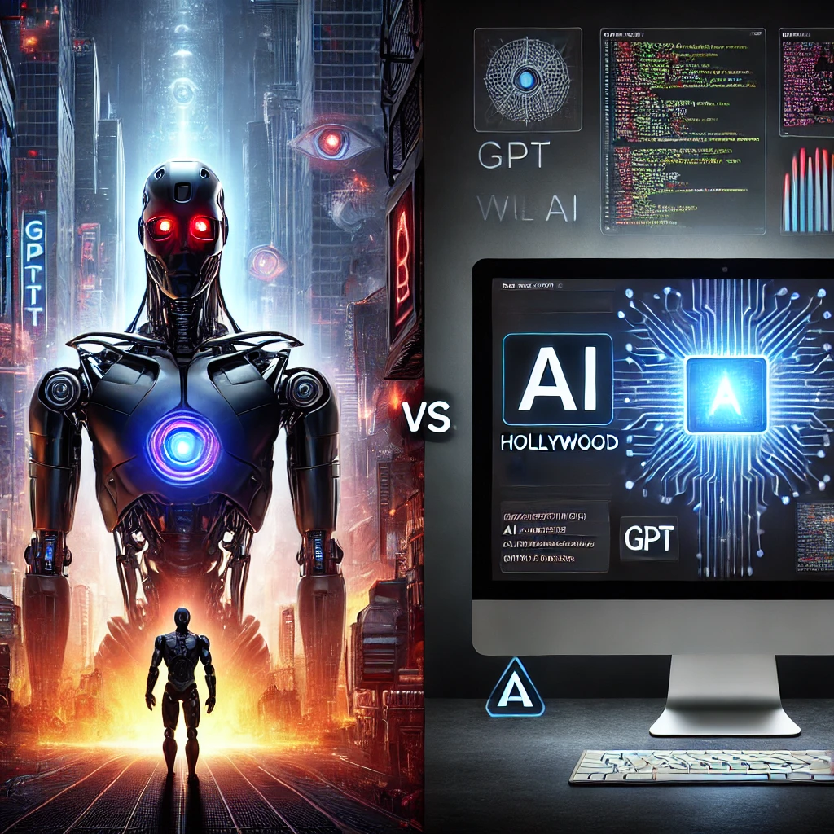
reality
AI does not "think" independently, it relies on training data.
AI will not "take over the world," but misuse of AI (deepfakes, automation in hacking) is a real concern.
Notes:
In cybersecurity, this matters a lot. AI can follow programmed rules to detect threats or block traffic, but it can’t decide what’s ‘right’ or ‘wrong’ on its own. For instance, if an AI’s training data is biased—say, it flags certain users more often due to skewed patterns—it might block a legitimate employee. That’s where humans step in to correct the course.
AI does not think like a human—it learns patterns from training data and applies those patterns to new inputs.
AI lacks emotion, intuition, and reasoning—it does what it’s programmed to do.
This myth has real implications. Ethical dilemmas in cybersecurity—like balancing privacy with security—require human judgment. AI can’t weigh the moral trade-offs or understand the human context behind a decision. That’s our job
Comment about 0s and 1s

Slide 8
Myth #3 “AI Will Replace All Jobs”
Notes:
For our final myth: the belief that AI will replace all cybersecurity jobs.
It’s a scary thought for many in this field, but the reality is more nuanced. AI is incredibly powerful at automating repetitive tasks—things like scanning logs for threats, detecting patterns in massive datasets, or even flagging a potential phishing email in real-time.
There’s a widespread fear that AI will replace cybersecurity jobs, leading to mass unemployment.
News headlines fuel this concern, often exaggerating AI’s capabilities.
Example quotes from the media:
“AI and Automation Could Wipe Out Millions of Jobs” – [Forbes, 2023]
“Will AI Replace Cybersecurity Analysts?” – [TechCrunch, 2024]
But is this really the case? What do the numbers say?

Slide 9
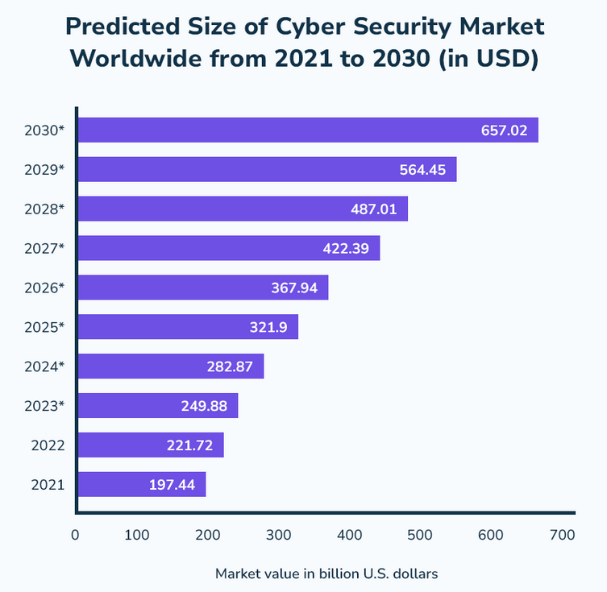
Reality
AI augments human jobs rather than fully replacing them.
AI should be used as a tool, not a decision-maker.
Source: https://www.stationx.net/cyber-security-job-statistics/
Notes:
AI is not replacing cybersecurity jobs—it’s augmenting them.
AI tools can process vast amounts of security logs, identify potential threats, and reduce response time, but…
AI lacks human intuition, context awareness, and decision-making skills.
AI models can make false positives or miss novel attack techniques.
Cybersecurity professionals are still needed to interpret AI-generated alerts, investigate incidents, and make critical decisions.
Example:
if AI flags a suspicious email, a human analyst steps in to investigate the context and intent. It’s a partnership, not a replacement
Computer in old days example
Emerging Job Categories:
AI is creating new cybersecurity job roles:
AI Security Specialist – Ensures AI models used in cybersecurity are robust and secure.
AI Ethics Officer – Focuses on ensuring AI systems are fair, unbiased, and used ethically.
AI Incident Response Analyst – Investigates how attackers manipulate AI-based security defenses.

Slide 10
Ethical Challenges & Human Responsibility
Notes:
Now that we’ve covered these major myths, let’s talk about the ethical challenges and responsibilities we have when developing AI.

Slide 11
Ethical AI in Cybersecurity
Bias in AI models (e.g., biased threat detection due to skewed training data).
Privacy concerns (e.g., AI analyzing user data without proper consent).
Accountability: Who is responsible if an AI system fails—developer, user, or organization?
Notes:
First, there’s the issue of bias. If AI is trained on skewed data, it might unfairly flag certain users or regions as threats.
AI can inadvertently discriminate against certain groups if trained on biased data.
Example: AI-driven fraud detection disproportionately flagging transactions from specific regions.
Second, privacy is a concern—AI analyzing user data without consent can erode trust.
AI-based cybersecurity tools analyze massive amounts of data—this raises concerns about data collection, surveillance, and privacy violations.
Example: AI systems monitoring employee behavior may overstep privacy boundaries.
And third, accountability: if an AI system fails—say, it misses a breach—who’s responsible? The developer, the user, or the organization? These are gray areas we’re still figuring out.
Organizations should document AI models, track decision-making processes, and provide explanations for flagged security threats.

Slide 12
The Role of Cybersecurity Professionals
Ethical AI requires human involvement.
Organizations should implement AI responsibly (e.g., explainable AI, monitoring).
Notes:
AI cannot be left unchecked—human oversight is critical to ensuring ethical AI practices.
Ethical AI requires continuous monitoring, auditing, and governance.
Validating AI Decisions
Cybersecurity professionals must review and verify AI-generated alerts to prevent false positives and biased decisions.
Example: AI might flag a normal software update as malware—human analysts must investigate before taking action.
Ensuring Explainability & Fairness
AI should be transparent and accountable.
Organizations need frameworks for explainable AI (XAI) so security teams can understand AI decision-making.
Monitoring for AI Misuse
AI can be exploited by cybercriminals—security teams must be vigilant.
Example: AI-generated deepfake phishing attacks are becoming increasingly realistic.

Slide 13
The Future of AI in Cybersecurity
AI Development
Human Oversight
Ethical AI
Notes:
Let’s now turn our attention to the future of AI in cybersecurity. This slide represents a vision where AI doesn’t just exist in isolation but thrives through a continuous cycle of improvement.
We’re looking at three key elements: AI development, human oversight, and ethical AI—and how they work together to shape what’s ahead.
First, AI development is at the core. As technology advances, we’ll see smarter systems capable of detecting threats faster and adapting to new attack vectors. But—and this is critical—this process can’t happen in a vacuum. That’s where human oversight comes in. Humans will guide AI’s evolution, ensuring it aligns with real-world needs and catches what algorithms might miss, like those zero-day attacks we talked about earlier.
The third piece is ethical AI. As we build and oversee these systems, we must prioritize fairness, transparency, and accountability. This means tackling bias in training data, protecting privacy, and deciding who’s responsible when things go wrong. This cycle shows that each element feeds into the next—development informs oversight, oversight ensures ethics, and ethical considerations drive better development.
So, what does this mean for the future? We’re heading toward a partnership where AI and humans collaborate seamlessly, with ethics as the foundation.

Slide 14
conclusion
AI assists, not replaces, cybersecurity professionals.
AI can fail, and humans are needed for verification.
AI isn’t sentient, but it requires ethical considerations.
Notes:
Key Takeaways from Today’s Discussion:
AI will not replace all cybersecurity jobs—it will augment and assist professionals.
AI is not infallible—it can make mistakes, be biased, and require continuous monitoring.
AI will not become sentient—it is a pattern-based tool, not a thinking entity.
Ethical AI is essential—human oversight, transparency, and fairness are crucial.
The future of AI in cybersecurity is collaboration—AI and humans must work together to strengthen security.
AI in cybersecurity isn’t about replacing humans—it’s about empowering them.
We must use AI responsibly to enhance security while maintaining ethical and transparent practices.
The best cybersecurity strategy will always include AI as a tool, guided by human intelligence.

Slide 15
“AI is not a silver bullet for cybersecurity, it's a force multiplier. It enhances human expertise, but it cannot replace it.”
— Bruce Schneier (2023, August)

Slide 16
Thank you
https://www.linkedin.com/in/calderon-fernando/
https://medium.com/@calderon.fernando

